Slide 1
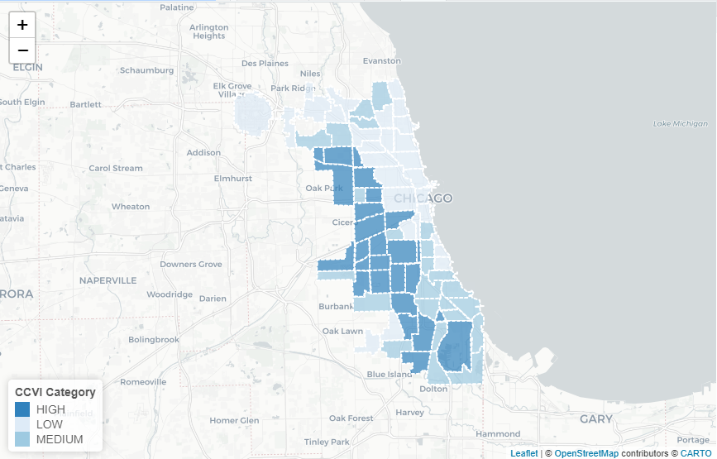
CCVI Distribution by Community Area

Slide 2
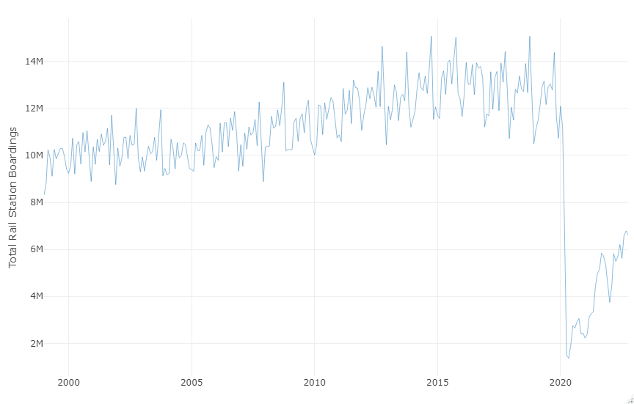
Monthly CTA Rail Station Boardings

Slide 3
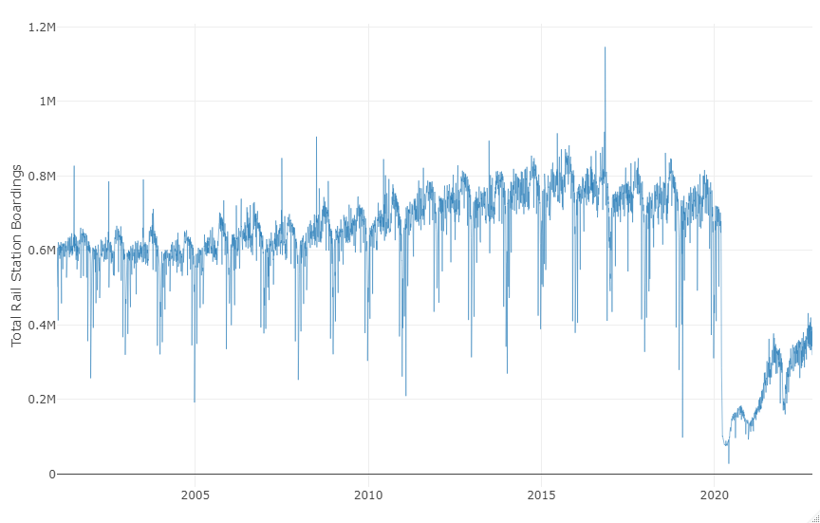
Daily CTA Rail Station Boardings

Slide 4
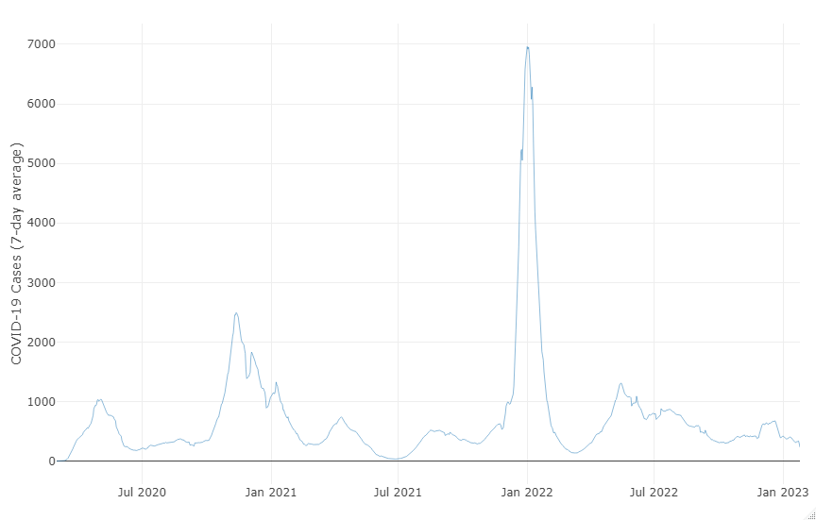
Weekly Chicago COVID-19 Cases

Slide 5
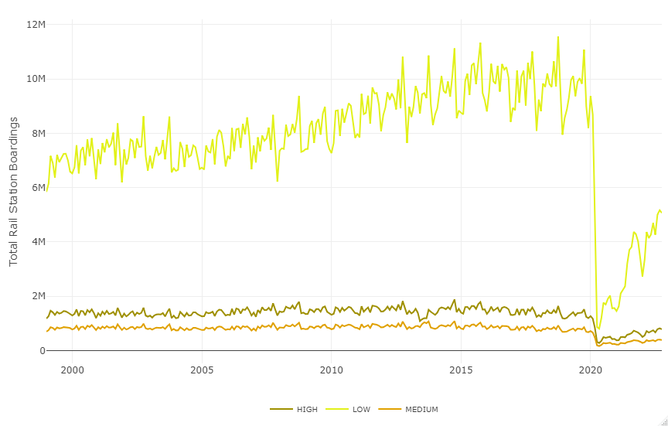
Ridership by Station Characteristics

Slide 6
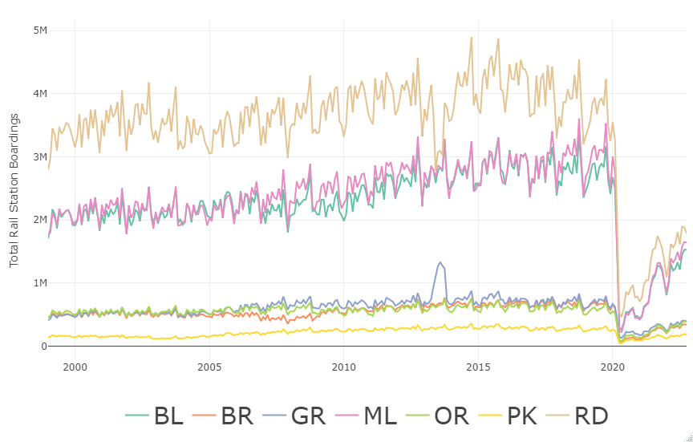
Rail Boardings by CTA Line

